Slide 1
KR meets Biomedicine
Peiqin Gu
2013-09-16

Slide 2
Outline
The state-of-the-art of KR
KR Techniques in Biomedicine
Case Studies
New Challenges
CM & KR
References

Slide 3
The state-of-the-art of KR
Traditionally,
  A surrogate that substitutes the thing itself.
  A set of ontological commitments.
  A fragmentary theory of intelligent reasoning.
  A medium of human expression.
  A medium for efficient computation.
Now, Knowledgable Web
  Knowledge graph, e.g. Google, Baidu, Schema.org
  Knowledge-aware applications, i.e., feature-value relations of people network, life science, etc.
Notes:
The notion of knowledge representation can be understood in terms of five distinct roles it plays.
A knowledge representation (KR) is most fundamentally a surrogate, a substitute for the thing itself, used to enable an entity to determine consequences by thinking rather than acting, i.e., by reasoning about the world rather than taking action in it.
It is a set of ontological commitments, i.e., an answer to the question: In what terms should I think about the world?
It is a fragmentary theory of intelligent reasoning, expressed in terms of three components: (i) the representation's fundamental conception of intelligent reasoning; (ii) the set of inferences the representation sanctions; and (iii) the set of inferences it recommends.
It is a medium for pragmatically efficient computation, i.e., the computational environment in which thinking is accomplished. One contribution to this pragmatic efficiency is supplied by the guidance a representation provides for organizing information so as to facilitate making the recommended inferences.
It is a medium of human expression, i.e., a language in which we say things about the world.

Slide 4
The state-of-the-art of KR
Recently, Ontology
  A new general concept, subsuming all kinds of existing KR systems, or at least all that use fixed concept-relation-structures.
  A new type of KR system, expanding the possibilities of traditional methods.
The roles of ontologies
  Vocabulary
  Content theory
  Databases
  Knowledge sharing

Slide 5
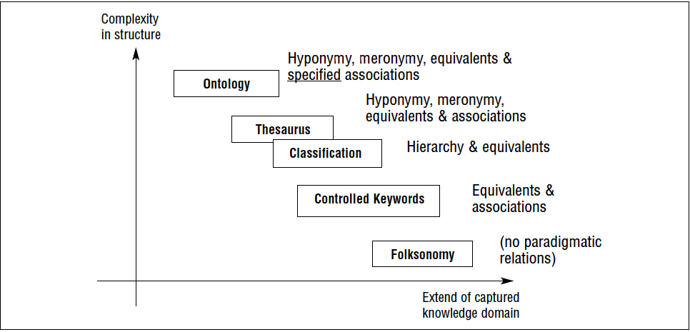
Approach to classify popular KR systems according to complexity in relational constructions

Slide 6
KR techniques in Biomedicine
GOAL
  Biology, especially medicine, are characterized by a wealth of terminologies, best described as language-oriented artifacts that relate the various senses or meanings of linguistic entities with each other [1].
  Deep understanding of the science and practice, problems, interactions, culture of biomedicine and health.
Terminology building block
  Synonymy (same meaning)
  Hyperonymy (broader meaning)
  Hyponymy (narrower meaning)
Ontology
  Which classes of entities are related to others
  Under which circumstances these relations hold
  How these relations should be exactly interpreted
  MeSH, GO, SNOMED-CT, FMA, UMLS, OBO

Slide 7
KR techniques in Biomedicine
Top-level ontology
  GFO (General formal ontology)
  BFO
  DOLCE
DL Rules and reasoning
  Consistency checking [3]
  Factual correctness
  Compositions of classes [8]
Annotation
Functionalities of an ontology repository [14]
  Ontology summarization
  Ontology ratings
  Online graphical browsing
  Multiple-ontology search
  Ontology mapping and alignment
Notes:
In a canonical ontology, relationships between its categories can be interpreted as default relations.

Slide 8
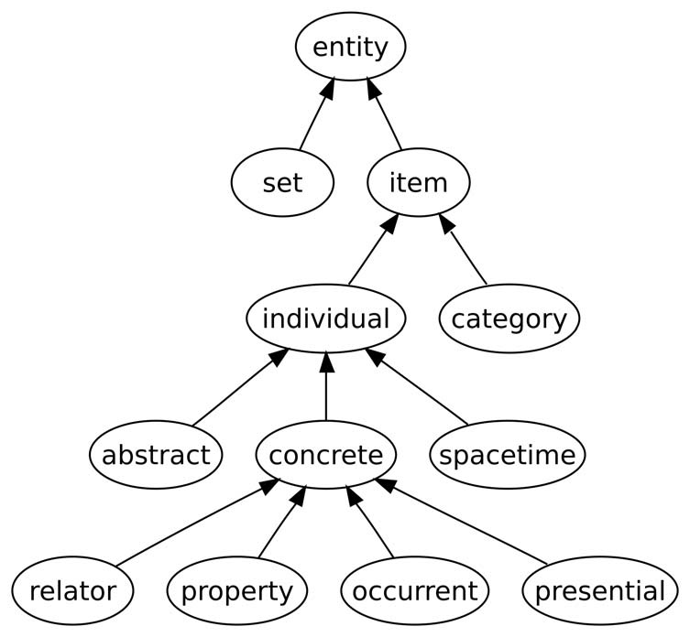
KR techniques in Biomedicine
Products
  Ontology-based Bio Wiki [9]
  Logic-based Query-answering system
  Ontology-based Decision support system
  Bio Linked Data
Notes:
A summary of what it covers.→top-lvel snapshots as the ontology’s metadata that help users make decision.
Deciding whether an ontology is appropriate for a particular use is a subjective task. → ontology quality → letting ontology users provide ratings and reviews can greatly help life-science researchers find out whether there is an existing ontology suitable for their projects.
Virtually no ontology libraries provide a comprehensive cross-ontology search capability. This type of capability would include a keyword search across multiple ontologies, a form-based search, a search for knowledge-base patterns, and so on.
Inevitably Create ontologies with overlapping content. With content elements that cannot gracefully connect, and sometimes with components that simply contradict one another.

Slide 9
Case studies
Domain ontologies
  Bio-ontologies: Phenotypes ontology [2], GO
  Terminology: UMLS, MeSH
  Clinical: SNOMED-CT
Discipline integration
  Systems biology and ontologies [6]
  Anatomy & phenotype ontologies [7]
  A bunch of linked data repositories: Linked Life Data, Bio2RDF, Bioportal
Personal clinic
  In western countries, clinical status are analyzed with user-tagged anatomy information.
  Lead to the right doctor, deliver personalized suggestions

Slide 10
New Challenges
Ontologies are fundamentally inadequate for representing the knowledge
  Part of, class subsumption, negation
KR with ontologies: present and future
  The range of knowledge as an ontology
  A set of interests, through the terms used
  Need inference to exploit formal semantics
Methodology expansion
  Spatial representation [18]
  Fuzzy logic reasoning [19]: Negation and uncertainty in clinical medicine
  Knowledge integration
  Making use of annotations [20]
  Combine ontologeis and folksonomies
    Social annotations with semantic recommendations
    Query expansion with ontologies

Slide 11
Chinese Med & KR
Characteristics
  Analogism → Analogy ontology
    Yin & Yang, Five elements, Hot & Cold
    Universe of things: Organs, Food, Blood, Qi, Diseases
  Vague notion → fuzzy KR, fuzzy rules
    E.g., symptom description, herbal medicine
    Obscure Clinical principles
  Experience-based → knowledge extraction
    Conceptual model
    Effective validation
Notes:
Analogy -> identify characteristic similarity and perform certain kinds of mapping
Vague notions of concepts ->

Slide 12
References
[1] Freitas F. Schula S. et al. Survey of current terminologies and ontologies in biology and medicine. RECIIS-Electronic Journal in Communication, Information and Innovation in Health, 3(1), 7-18, 2009.
[2] Mungall C., Georgios Gkoutos, et al. Representing Phenotypes in OWL. In OWLEL, 2007.
[3] Nadkarni P.M., Marenco L.A. Implementing description logic rules for SNOMED-CT attributes through a table-driven approach. Journal of the American Medical Informatics Association (JAMIA), 17(2), 182-184.
[4] Clark T. Knowledge Integration in Biomedicine: Technology and Community. Briefings in bioinformatics, 8(3), E1-E3, 2011.
[5] Greenes R.A., Shortliffe E.H. Commentary: Informatics in biomedicine and health care. Academic Medicine, 84(7), 818-820.

Slide 13
References
[6] Hoehndorf R., Dumontier M. et al. Integrating systems biology models and biomedical ontologies. BMC systems biology, 5(1), 124, 2011.
[7] Hoethndorf R., Loebe F. et al. Representing default knowledge in biomedical ontologies: application to the integration of anatomy and phenotype ontologies. BMC bioinformatics, 8(1), 377, 2007.
[8] Mungall C.J., Bada M. et al. Cross-product extensions of the Gene Ontology. Journal of biomedical informatics, 44(1), 80-86, 2011.
[9] Hoehndorf R. Bacher J. et al. BOWiki: an ontology-based wiki for annotation of data and integration of knowledge in biology. BMC bioinformatics, 10(Suppl 5), S5, 2009.
[10] Brewster C., O’Hara K. Knowledge Representation with Ontologies: The present and future. IEEE Intelligent Systems, 19(1), 72-81, 2004.

Slide 14
References
[11] Chandrasekaran B., Josephson J.R., et al. What are ontologies, and why do we need them? IEEE Intelligent Systems and Their Applications, 14(1), 20-26, 1999.
[12] Cimino James J, Zhu X. The practical impact of ontologies on Biomedical informatics. Yearb Med Inform, 2006, 124-35.
[13] Schulz S., Stenzhorn H., et al. Strengths and limitations of formal ontologies in the biomedical domain. Revista Electronica De Comunicacao. Informacao & Inovacao EM Saude. 3(1), 31, 2009.
[14] Noy N.F., Rubin D.L., et al. Making Biomedical Ontologies and Ontology Repositories Work. IEEE Intelligent Systems, 19(6), 78-81, 2004.
[15] Stevens R, Goble C.A., et al. Ontology-based knowledge representation for bioinformatics. Briefings in bioinformatics, 1(4), 398-414, 2000.

Slide 15
References
[16] Decker S, Fensel D, Van Harmelen, et al. Knowledge representation on the web. Description Logics, 33, 89-97, 2000.
[17] Brewster C., O’Hara K. Knowledge representation with ontologies: present challenges---future possibilities. International Journal of Human-Computer Studies, 65(7), 563-568, 2007.
[18 ]Donnelly, Maurren, et al. A formal theory for spatial representation and reasoning in biomedical ontologies. Artificial Intelligence in Medicine 36, No.1(2006), 1-27.
[19] Boegl K., Adlassnig K.P, Hayashi Y., et al. Knowledge acquisition in the fuzzy knowledge representation framework of a medical consultation system. Artificial Intelligence in Medicine, 30(1), 1-26, 2004.
[20] Wimalaratne S.M., Grenon P., et al. An infrastructure for ontology-based information systems in biomedicine: RICORDO case study. Bioinformatcis, 28(3), 448-450, 2012.
[21] Weller K. Folksonomies and ontologies: two new players in indexing and knowledge representation. Applying web, 2, 108-115, 2007.

Slide 16
THE END
THANKS FOR YOUR ATTENTION!

